Slide 1
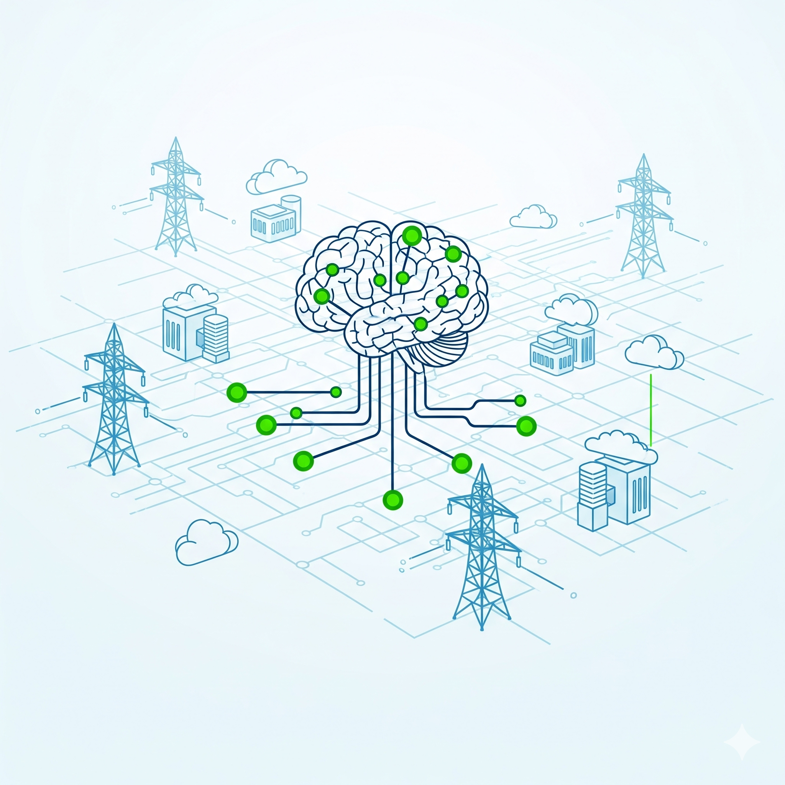
IRENO Smart Assistant
Generative AI-Powered Interface for Electric Utilities
IRENO Team | October 2024

Slide 2







What is IRENO?
Comprehensive Platform
Multi-Role Support
Manages electric and gas utility operations.
Serves field technicians, operators, and senior leadership.
AI-Powered Innovation
Conversational Insights
Natural language interface for data interaction.
Transforms complex data into actionable dialogue.
IRENO provides real-time data and insights for field operations, now enhanced with an AI-powered Smart Assistant that converts complex utility data into conversational insights.

Slide 3

The Challenge
Electric utility workers often struggle with slow decision-making due to complex APIs and dashboards. Field technicians need instant information during emergencies, but traditional interfaces lack intuitive interaction, leading to information silos and inefficient operations.
Multiple Systems: Workers navigate various interfaces and tools.
Data Complexity: Technical information is hard to interpret quickly.
Communication Gaps: Information doesn't flow efficiently between roles.
Time-Critical Decisions: Emergency situations demand immediate data access.
Training Overhead: Complex systems require extensive user training.
Problem: Disconnected systems lead to significant delays in critical response times and increase training burden for new personnel.

Slide 4



Our Technical Architecture
1
2
3
Frontend
Backend
Integration
React 18 + Vite
Python Flask 3.0.0
Secure JWT Authentication
CSS Modules
LangChain Framework (RAG)
RESTful API-First Design
Responsive Design
Azure OpenAI GPT-4o
Our three-tier architecture ensures a scalable, maintainable, and secure solution. This modern stack, with component-based UI and microservices backend, is optimised for performance and user experience.

Slide 5
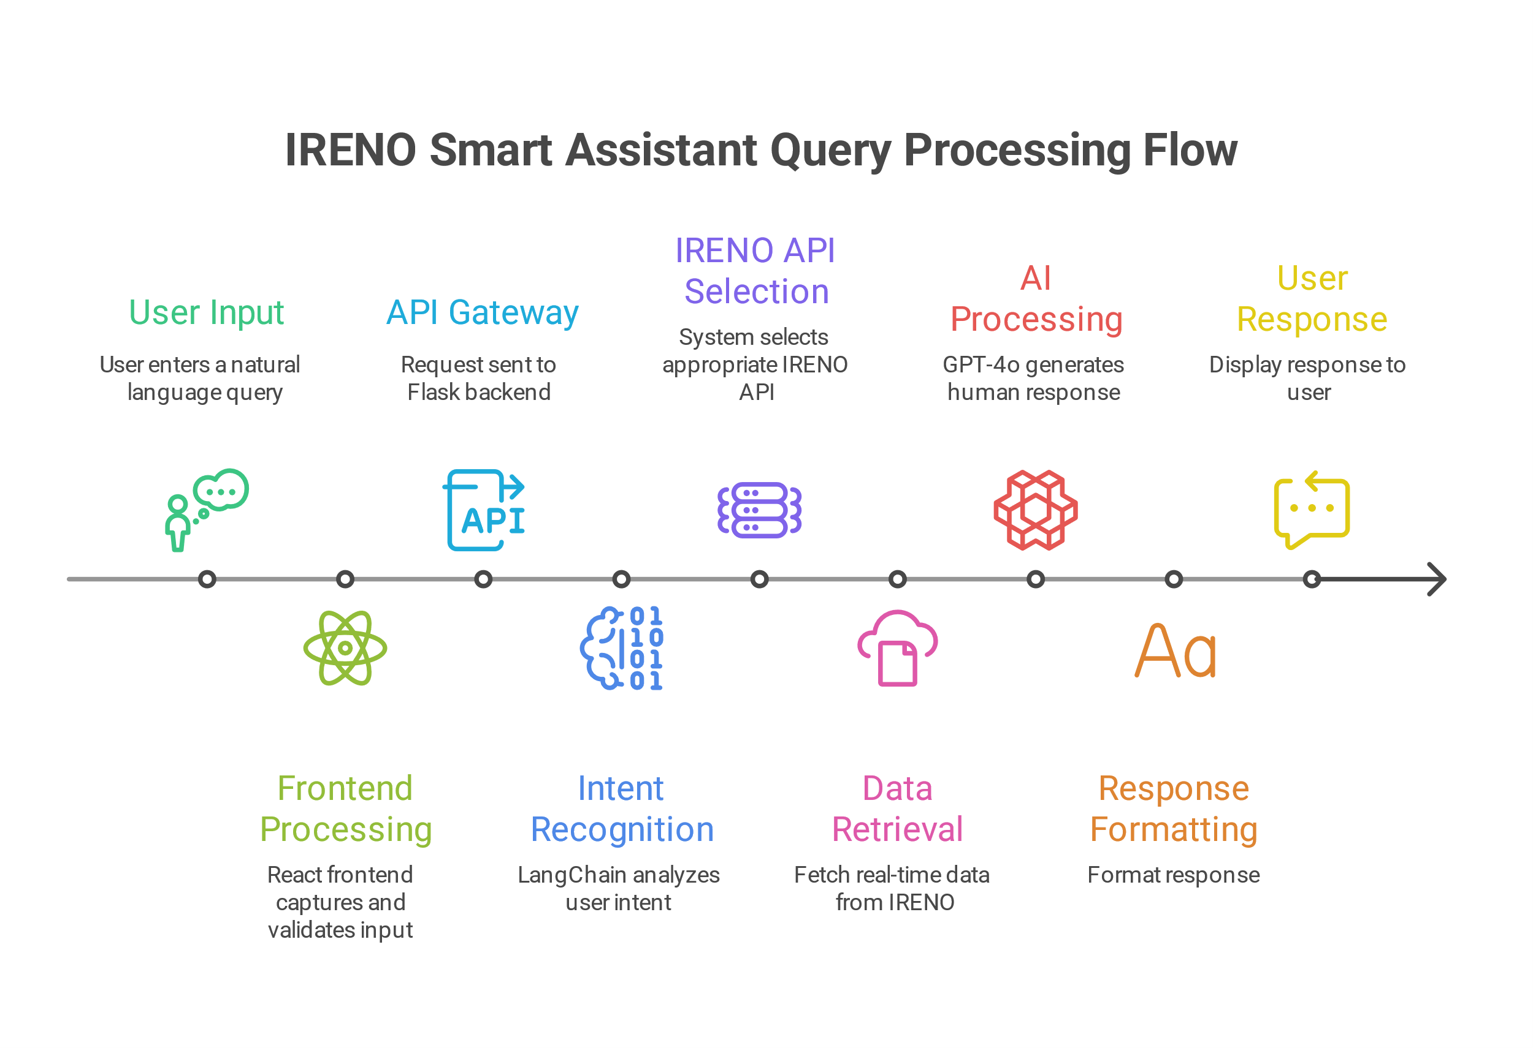
How It Works: Query Processing Flow
01
02
03
User Input
Intent Recognition
API Integration
Natural language query via chat interface.
AI analyses user request and context using LangChain.
System calls appropriate IRENO APIs (e.g., collectors, operations).
04
05
Data Processing
Response Generation
LangChain processes and contextualises data with RAG.
GPT generates human-readable responses from technical data.
07
Conversation Memory
Context is maintained for seamless follow-up queries.
This natural language interface streamlines data access, intelligently routing queries and providing contextual, accurate responses.

Slide 6
Impact & Future Enhancements
Current Benefits
Faster information retrieval
Eliminates training overhead
Multi-role support
Future Enhancements
Voice interface for hands-free operation
Predictive analytics and recommendations
Mobile app for field workers
The IRENO Smart Assistant transforms how utility workers interact with data, providing instant, actionable insights through a simple conversational AI.

Slide 7
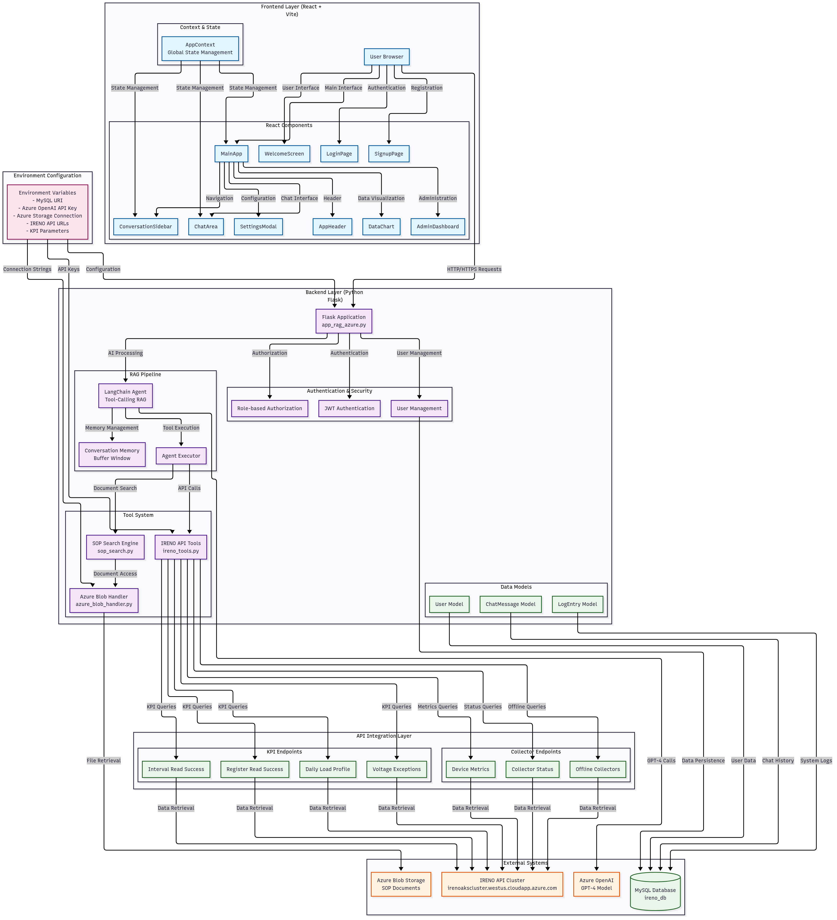
Thank You

